Slide 1


Mushrooms and U.S. Infrastructure
By Will Allstead

Slide 2
Overview
U.S. infrastructure problem
Current solutions
Mushrooms might help
Upsides
Downsides

Slide 3
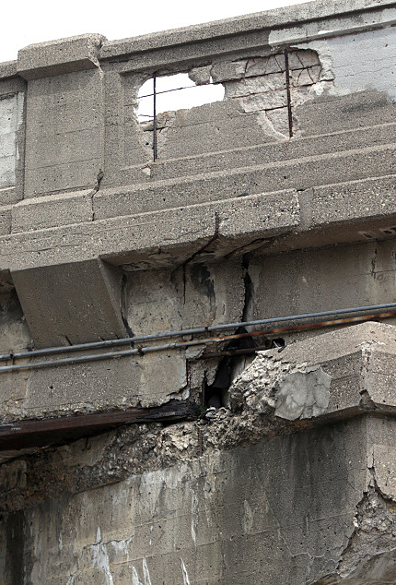
U.S. Infrastructure Problem
Concrete cracks and crumbles over time
Can lead to costly repairs of important infrastructure
Money
Time
Image From: publicradio.org
www.publicradio.org/content/2015/07/16/20150716_20150715bridge_monroe05_53.jpg

Slide 4
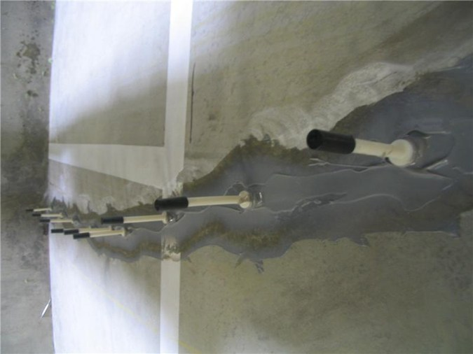
Current Solutions
Replacing concrete completely
Filling cracks with epoxy
What if concrete could fix itself?
Image From: conspecmaterials.com
www.conspecmaterials.com/wp-content/uploads/2015/08/ATC-Adhesives-Technology-Crack-Kit-Concrete-Repair-Epoxy-application.jpg

Slide 5
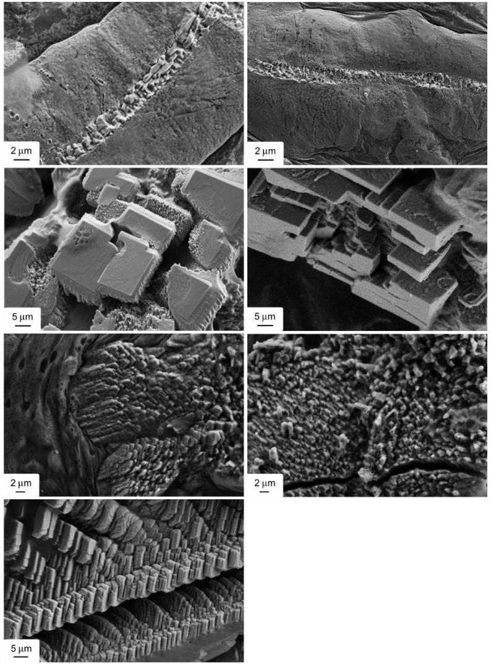
Mushrooms Might Help
Mixing in fungal spores (Trichoderma reesei) when pouring concrete could be a solution.
Spores will germinate and produce calcium carbonate deposits that fix the cracks.
Image From: arxiv.org (Edited for clarity)
https://arxiv.org/pdf/1708.01337.pdf

Slide 6
Upsides/Downsides
Upsides:
Cheaper than current solutions
Lasts longer
Benign for humans
Downsides:
Would not fix current infrastructure
Further research is required before implementation

Slide 7
Conclusion
U.S. infrastructure problem
Current solutions
Mushrooms might help
Upsides
Downsides

